Slide 1
Introduction to apcs
in c++
prerequisites: none

Slide 2
What is apcs
Implementation(實作)
C++/Python
Levels
1 -> 不要忘記去考
2 -> 具有程式撰寫能力
3 -> 具有良好程式撰寫能力
4 -> 挑戰特殊選才
5 -> 挑戰奧林匹亞
Conception(觀念)
Only c++
Levels
比較沒鑑別度
秀出來就是比較屌

Slide 3
How should I prepare apcs?
Implementation
c++ or python
Logic
Logic
Logic
magic
Conception
C++
Literacy of scary C++
Patience & not getting angry
Math
Combinatorics
Logic
magic

Slide 4
What is c++
A programming language
Very simple if you know English and math

Slide 5
How should I learn c++
Zerojudge
register your own account
Environment
download Codeblocks
Be creative
But Don’t take drugs

Slide 6
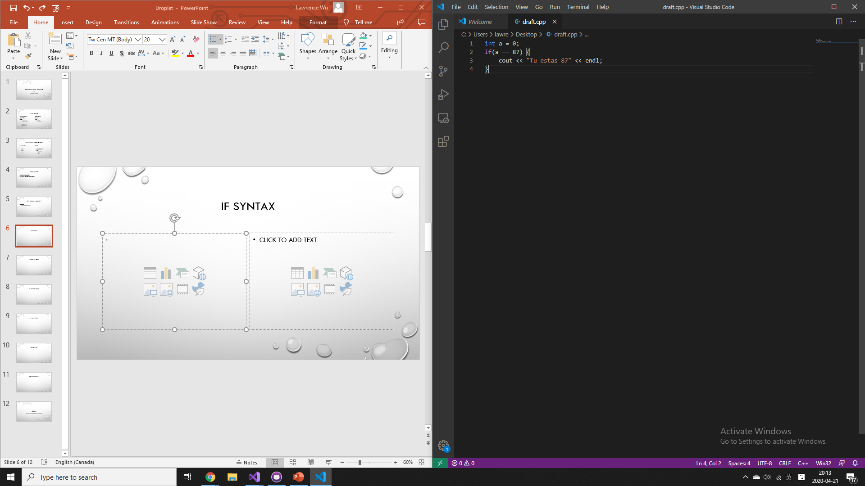
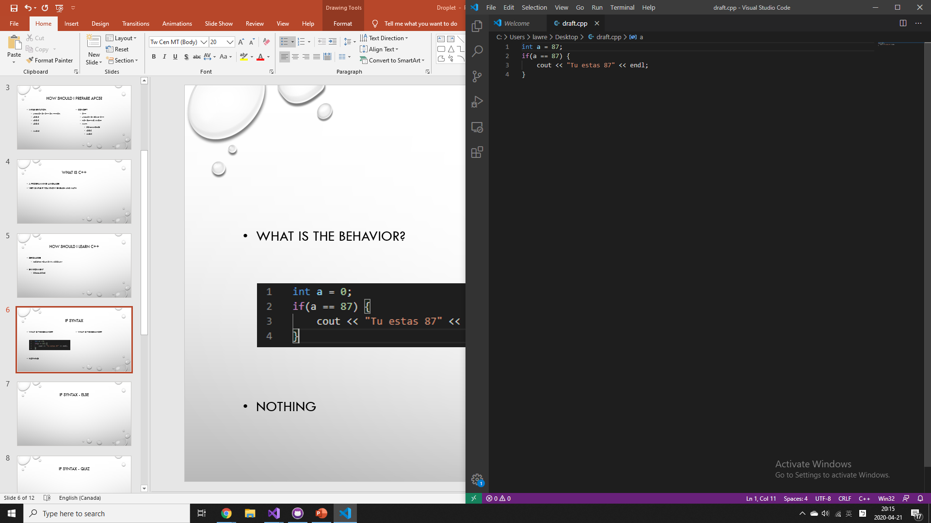
If syntax
what is the behavior?
Try it!
What is the behavior?
Guess it!

Slide 7
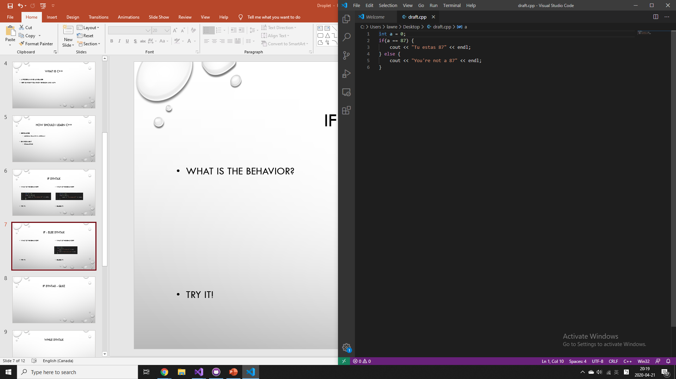
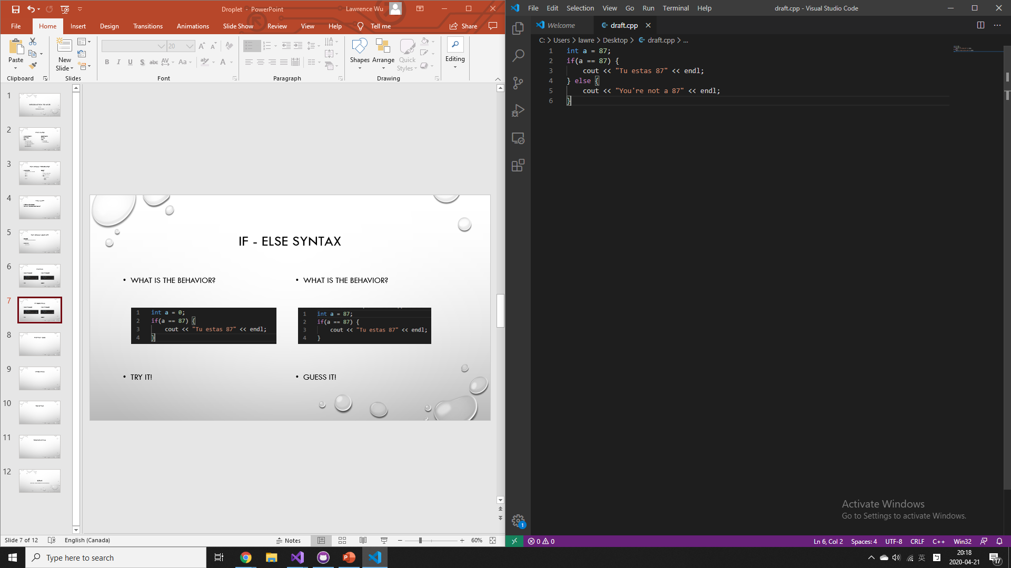
If - else syntax
what is the behavior?
Guess it!
What is the behavior?
Guess it!

Slide 8
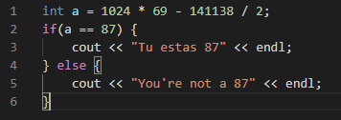
If syntax - quiz
What is the behavior?
You may use a calculator, but you may not use any programmable device

Slide 9
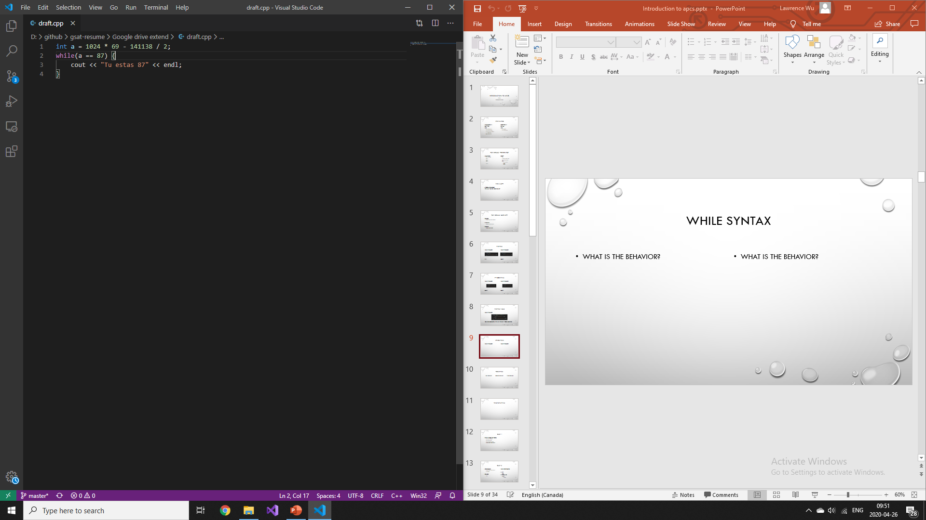
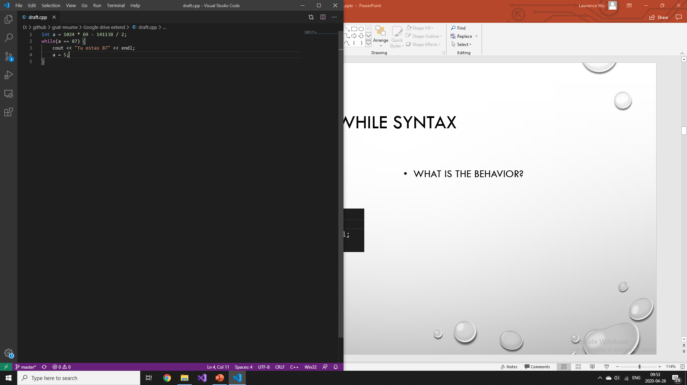
While syntax
What is the behavior?
What is the behavior?

Slide 10
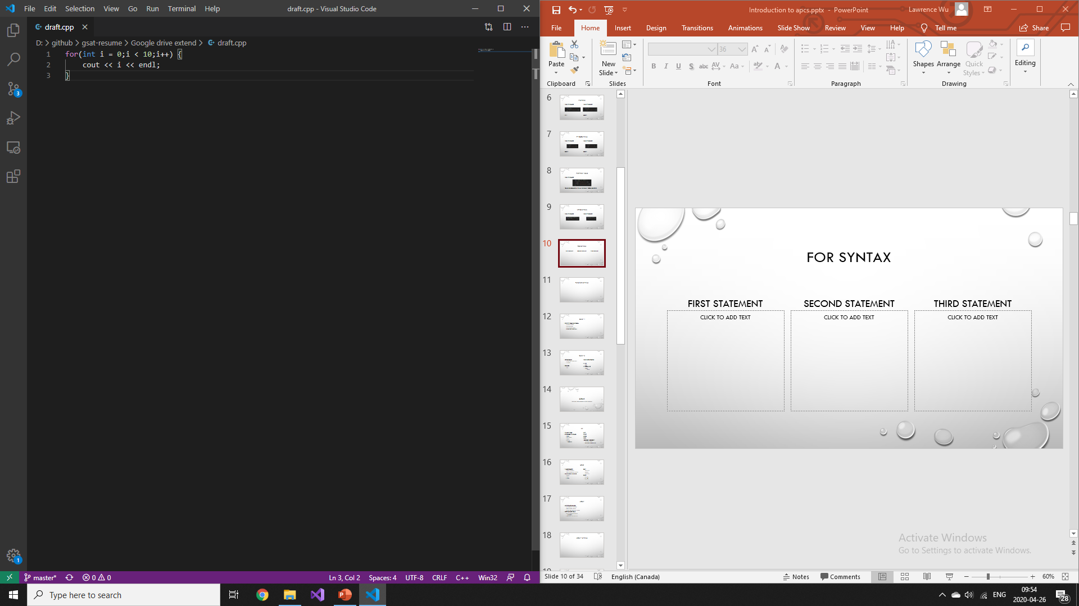
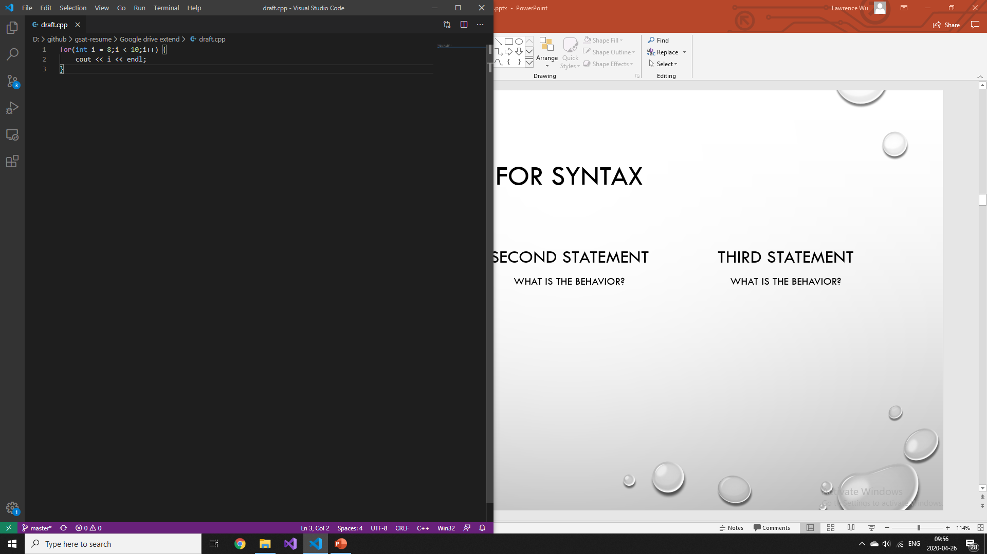
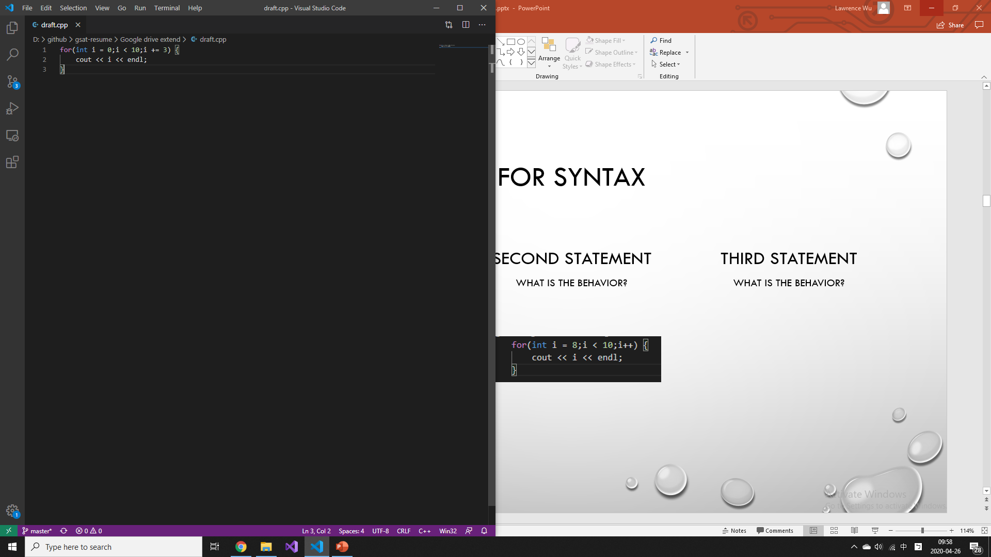
For syntax
First statement
Second statement
Third statement
What is the behavior?
What is the behavior?
What is the behavior?

Slide 11
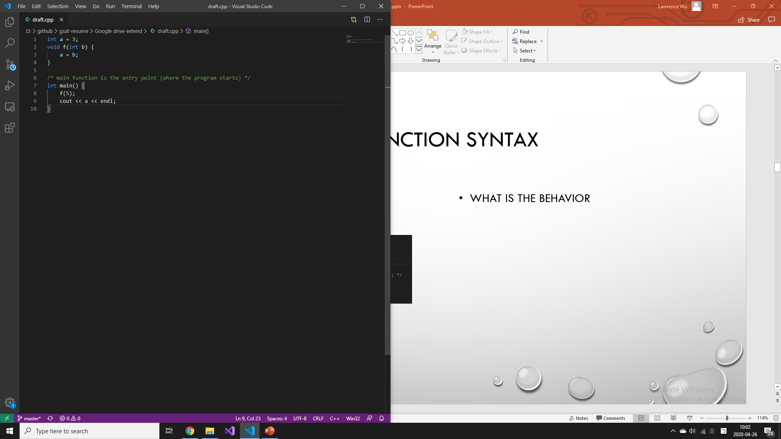
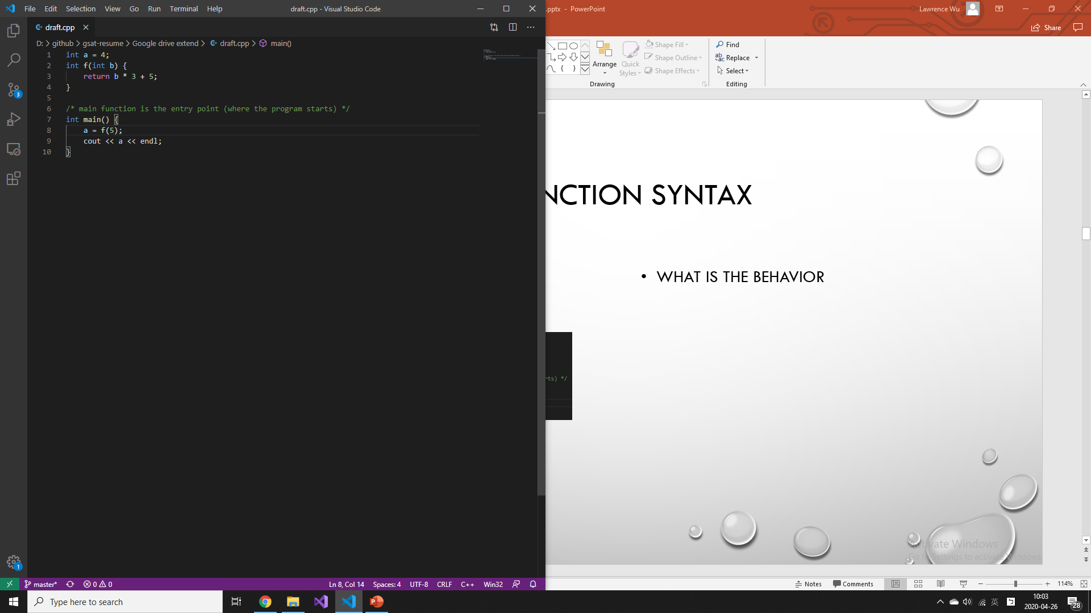
Function syntax
What is the behavior?
What is the behavior

Slide 12
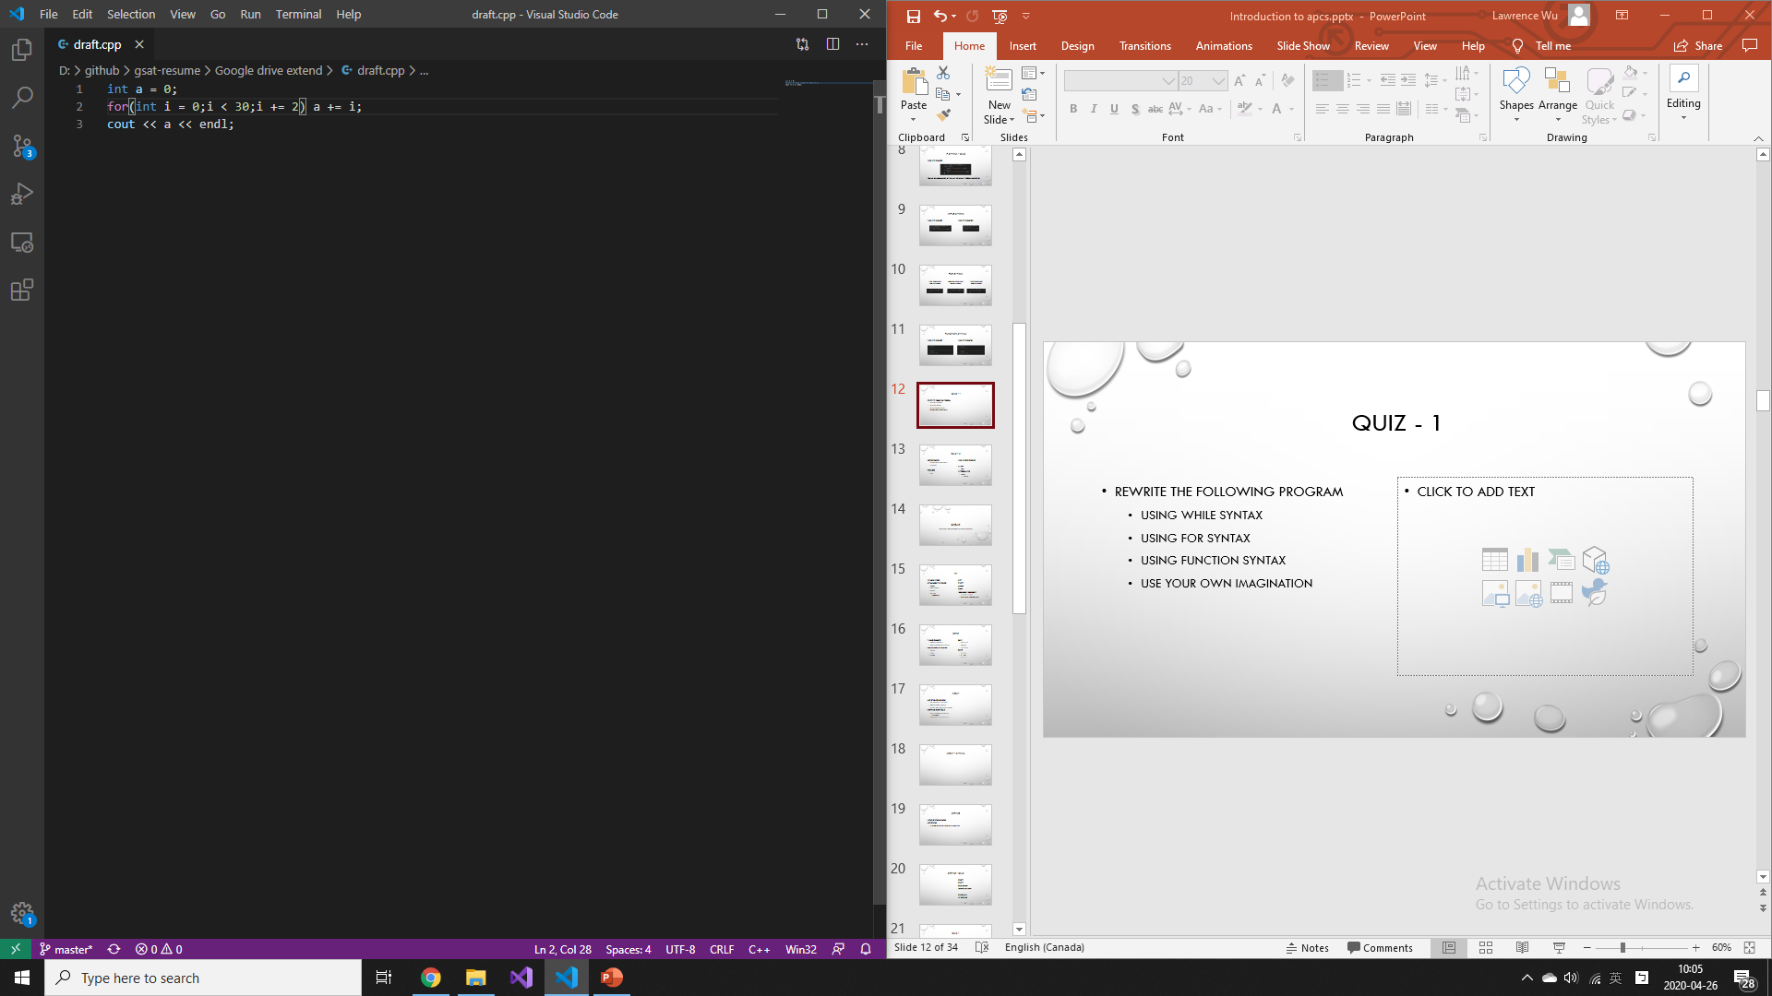
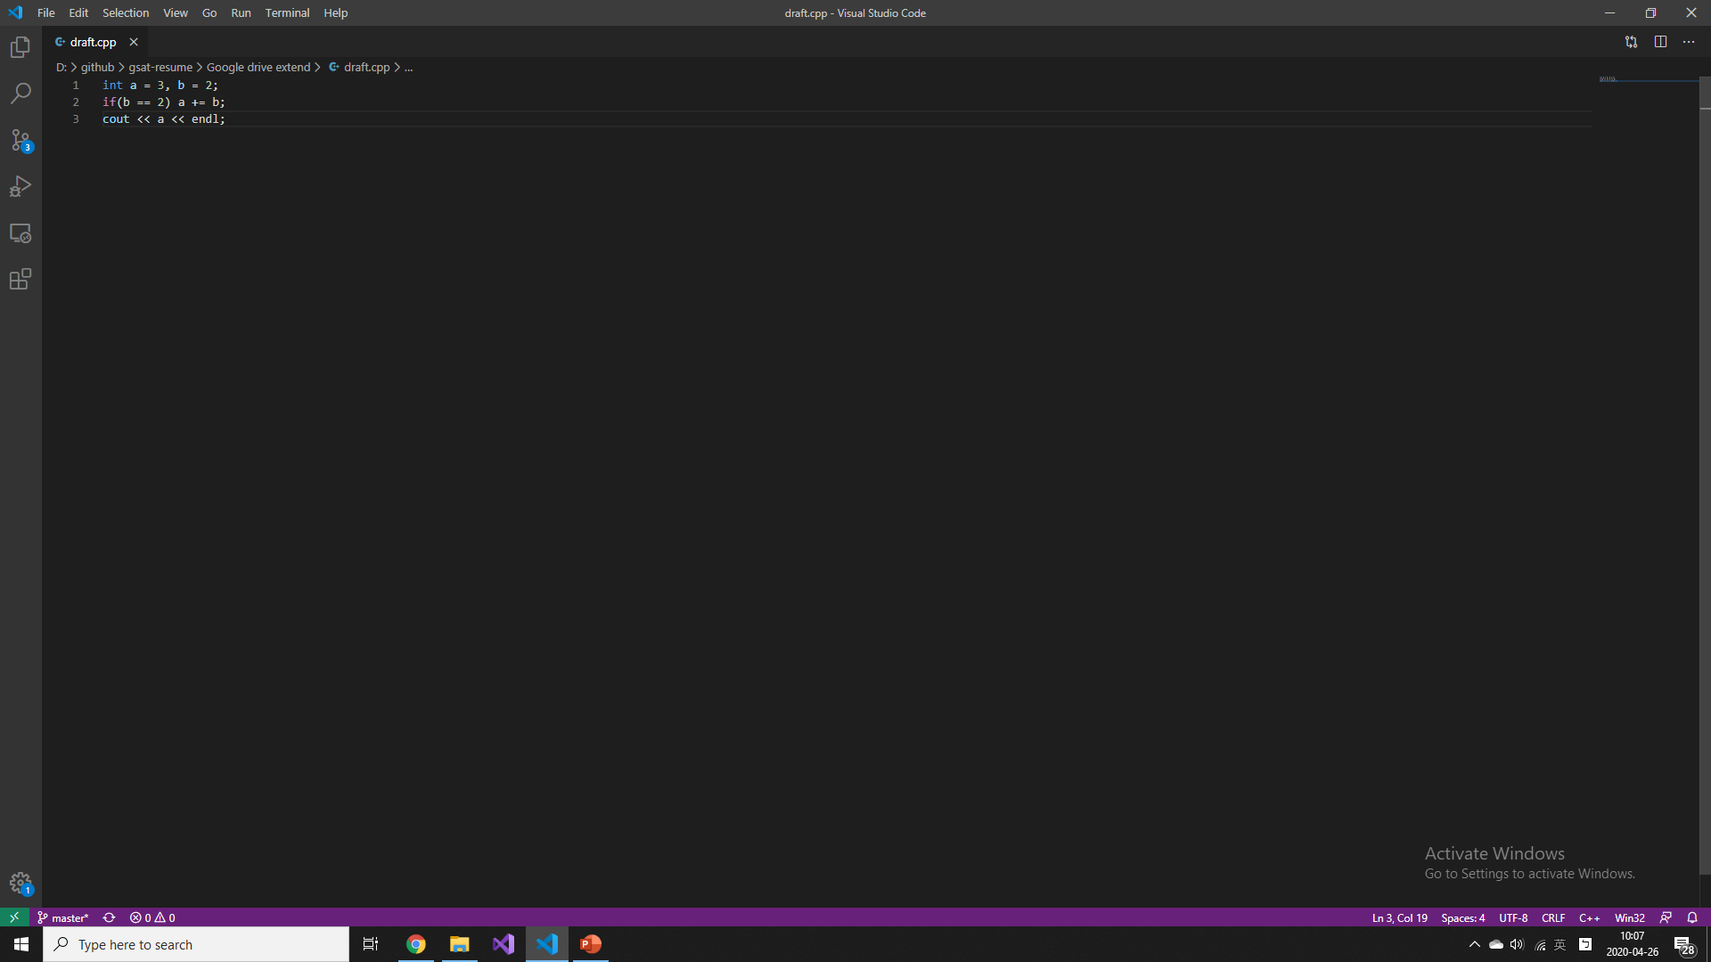
quiz - 1
Rewrite the following program
Using while syntax
Using for syntax
Using function syntax
Use your own imagination

Slide 13
Quiz - 2
Nested structure
Use your own imagination
Be creative
Zerojudge
d069
What is nested structure
In math
F(g(x))
In programming
If a==9
If a==10

Slide 14
Break
Let’s take a break before we burn our brain

Slide 15
int
Int means integer
Let talk about it’s behavior
Division
Multiplication
Modulo
Maximum
Around 2e9
5/2=?
5*2/2=?
5/2*2=?
5%2=?
1000000000*1000000000=?
Unknown behavior
Might cause program to crash

Slide 16
char
It means character
Only one character
Multiple characters are string
Let’s talk about its behavior
‘a’+3=‘C’
‘B’-’A’=1
‘9’-’0’=9
Quiz 1
‘a’+(‘Z’-’Y’)=?
‘A’+9/2=?
‘P’+(‘Y’-’Z’)=?
Quiz 2
‘0’ + ’0’=?
‘0’ * ‘0’=?
‘0’ / ‘0’ = ?

Slide 17
array
A set of objects are array
One dimension -> sequence
Two dimension -> matrix
Three or more dimension -> tensor
Everything starts from 0
When a programmer counts
0,1,2,3,4,5,…
Always starts from Fucking 0

Slide 18
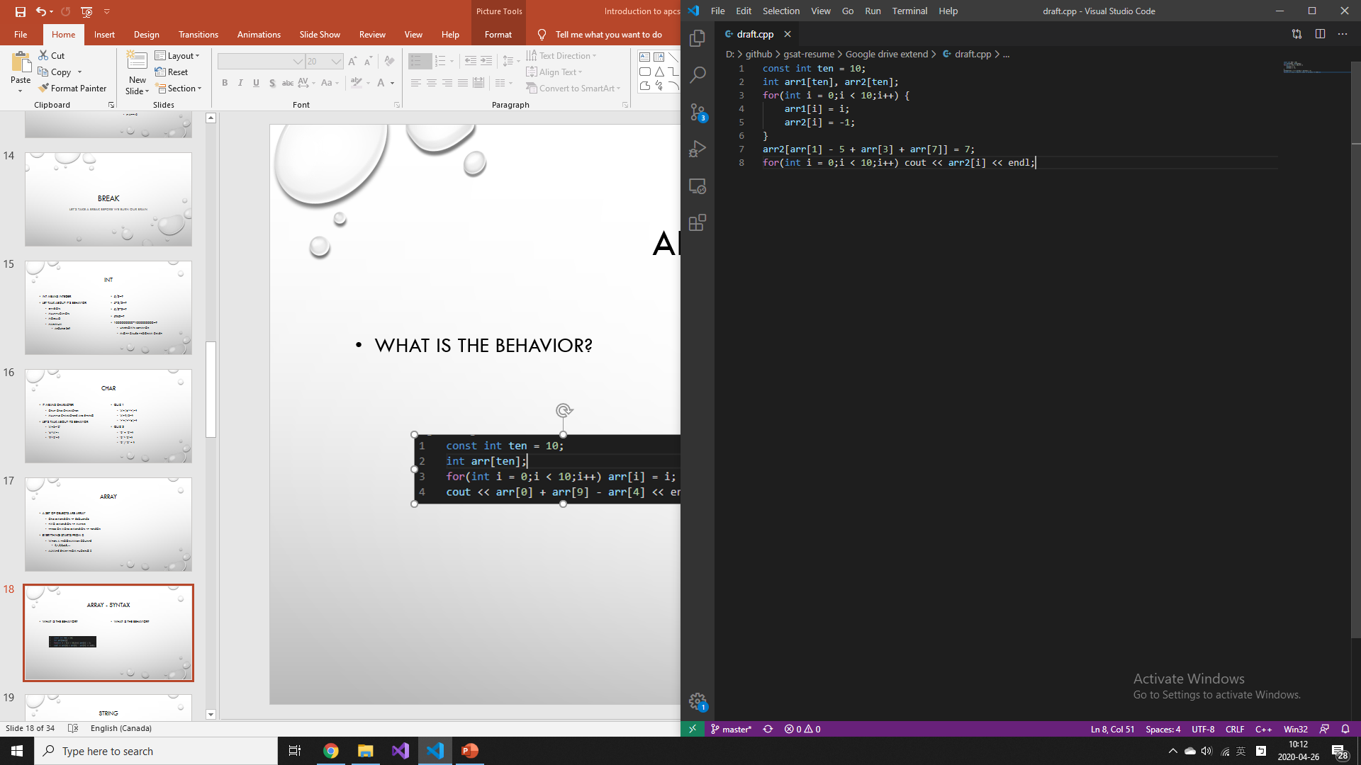
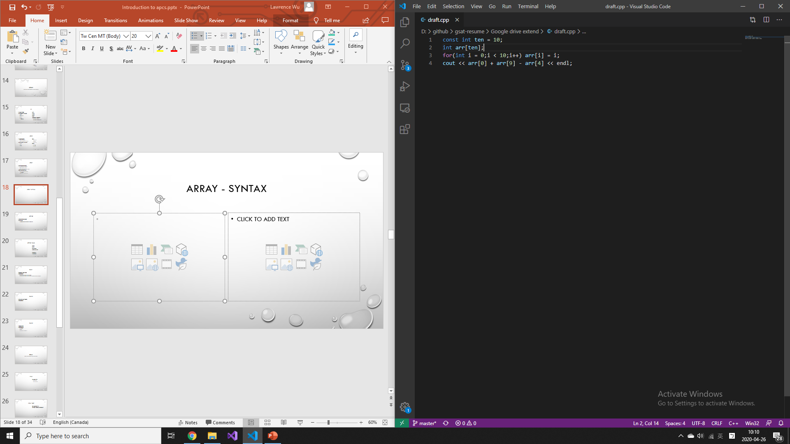
Array - syntax
What is the behavior?
What is the behavior?

Slide 19
string
Mixture of char and array
A set of char
Like a word, sentence, paragraph or some text

Slide 20

String - quiz
Str[0]=?
Str[9]=?
Str[9]-str[0]=?
Arr[0][3]-arr[1][2]=?
String to int
Int to string

Slide 21
Quiz 1
Storaging a huge integer
Zerojudge a021
Implement Only addition and subtraction
Implement multiplication and division when you want to torture yourself

Slide 22
Quiz 2
Simple matrix multiplication
Zerojudge d481

Slide 23
Quiz 3
Fibonacci series
Zerojudge d486
By recursion
By loop
By matrix multiplication…?
By your imagination…?

Slide 24
break
Don’t burn your brain yet, we still need it

Slide 25
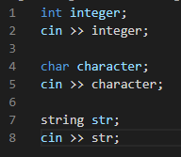
input
Terminates when
Meet a space
Meet a enter(‘\n’)
Char
Read only one character
String
Read a entire word
Integer
Read a entire number

Slide 26
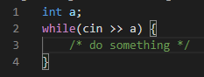
Input - eof
Eof means end of file
Not really Practical in development
Really useful in apcs

Slide 27
Input quiz
Input with n lines and without spaces
Input with unknown lines and without spaces

Slide 28
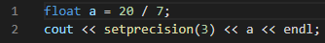
output
Cout
Setprecision
endl

Slide 29
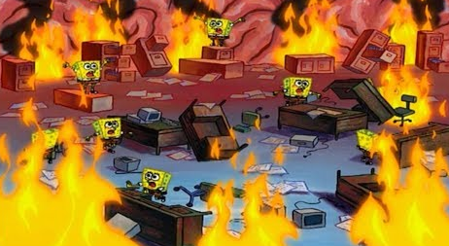
break
Describe your status with a meme

Slide 30
simple homeworks
Zerojudge
A001
A002
A006
A013
A015
Not necessary to finish

Slide 31
Normal homeworks
Zerojudge a021
Implement multiplication and division
Zerojudge a024
Implement Euclidean algorithm
Necessary to finish

Slide 32
HARD HOMEWORK
ZEROJUDGE A007
IMPLEMENT Eratosthenes sieve
NOT NECESSARY TO FINISH

Slide 33
Techniques
Go for the partial scores
You don’t have to solve the entire problem
the former problems are usually easier than the latter problems
‘usually’
‘usually’
Not always

Slide 34
extra
Recursion
Standard library(stl)
Expotationing by squaring
math
Modulo and fermat’s little theorem
Pascal triangle
Bitwise operations
Sorting
Time complexity estimation(prerequisites: calculus)

